Slide 1
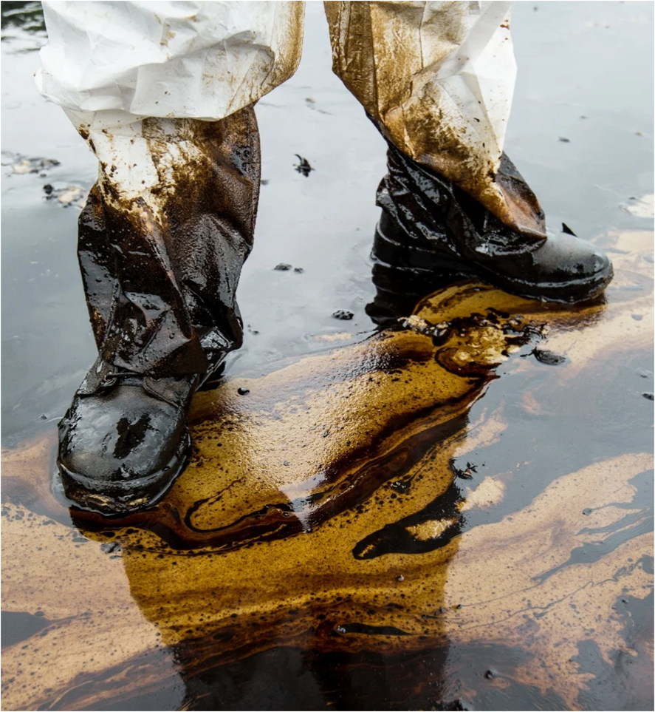
Health and Safety during a Response
Notes:
Introduce responder safety as the highest priority during spill response. Explain that all operations must be planned and executed to protect personnel, the public and the environment.

Slide 2
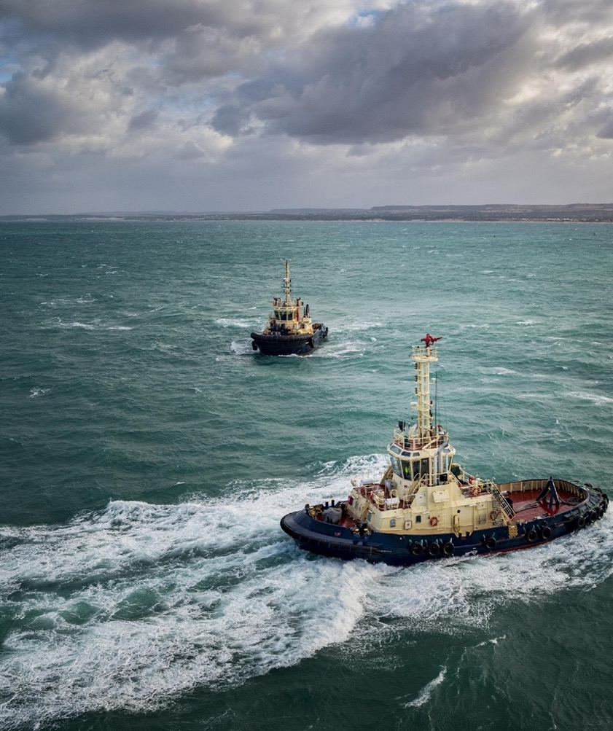

Health and Safety during a Response
Objectives
1
Recognise the potential hazards on a spill
2
Understand the key elements of a safety plan
3
Understand the health and safety aspects of oil spill response Identify areas of risk
Notes:
Review the learning objectives and explain how hazard identification, risk assessment, PPE selection and site control all work together to reduce risk.

Slide 3

Why is Health & Safety different on an oil spill compared to your normal operations?
Notes:
Ask participants why safety management during a spill may differ from routine operations. Discuss unfamiliar locations, changing conditions, extended shifts and exposure to contaminants.

Slide 4
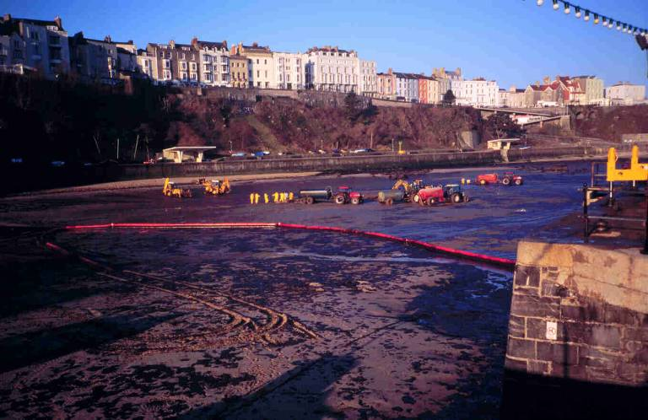
Hazard Identification
Weather
Experience
of plant operators
Locals
Sinking sand
Plant machinery
High pressure hoses
Oil
(slippery, carcinogenic)
Possibility of losing
equipment into the sand
Dock wall
(working at height)
Beach (tidal)
Notes:
Facilitate a hazard identification exercise. Encourage participants to identify all hazards shown and discuss controls for each one.

Slide 5
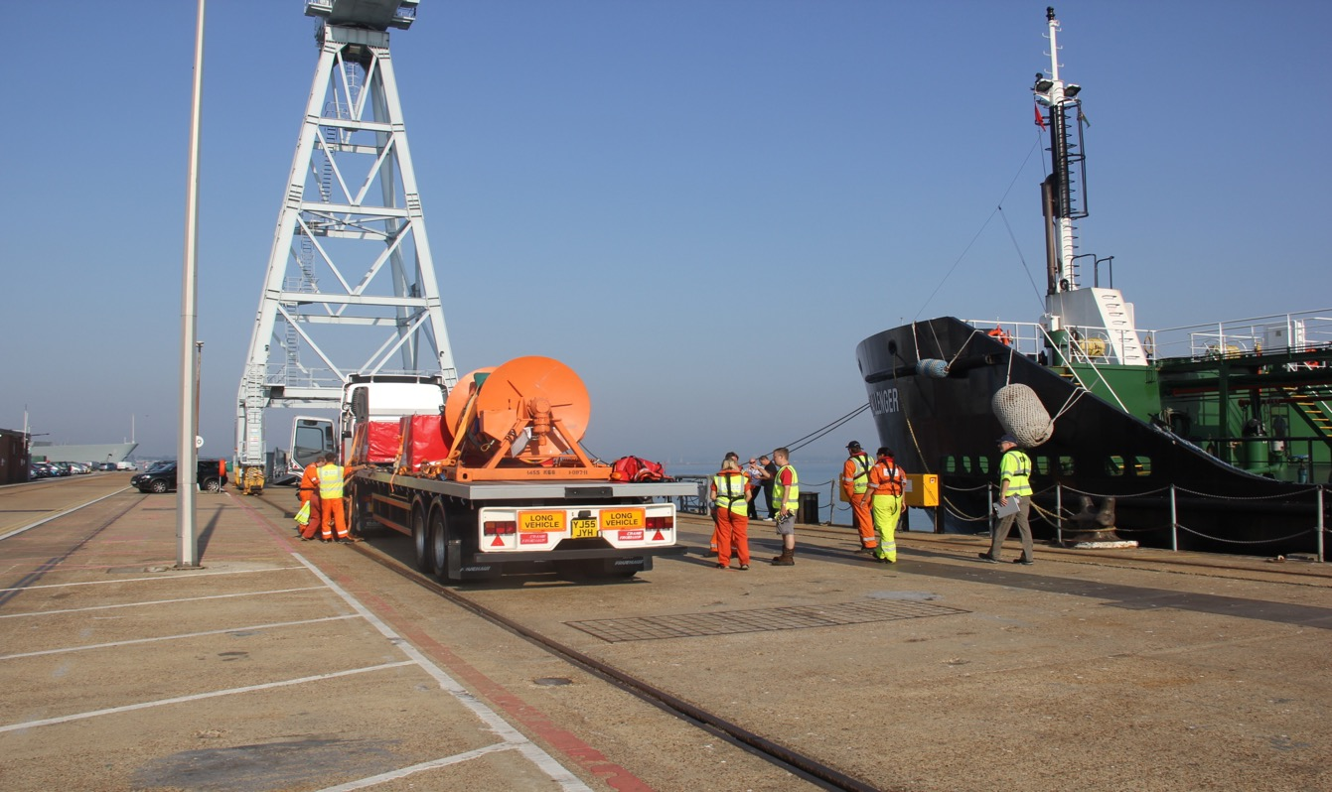
Hazard Identification
Crane Operations
Weather
Obstructions
Insert a second Picture for the trainer to choose.
Vessels
Working Near water
Vehicle Operations
Heavy Equipment
Other Vehicles
Equipment unloading
Personnel Working
Dock side
(working at height)
Slips, Trip & Falls
Notes:
Use the operational image to identify hazards associated with lifting operations, vehicle movements, vessels, weather, working near water and personnel interactions.

Slide 6
QS
Who is responsible for Safety on a site?
Notes:
Ask the question: who is responsible for safety? Lead participants to the conclusion that safety is everyone’s responsibility, from management to individual responders.

Slide 7


The Oil Itself
Information about the oil’s specific hazards can be found on its MSDS
  Flammability
  Explosive vapours
  Toxicity
  Hydrogen sulphide
  Exclusion of oxygen
  Product properties
The “weathering process” will influence some of the above.
Notes:
Review the properties of oil that may create hazards including flammability, toxicity, explosive vapours, oxygen displacement and hydrogen sulphide exposure. Explain weathering effects.

Slide 8
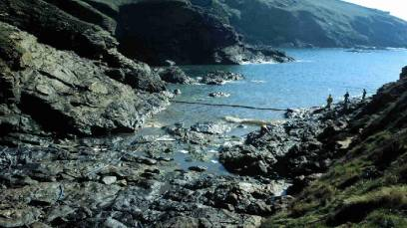
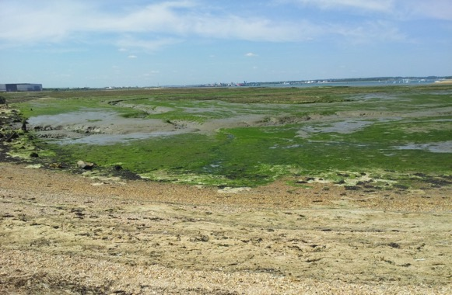
The Working Environment
An oil spill can occur in almost any environment whether it be offshore, inland or near shore.
Each location will have it’s own hazards and it is the job of the responders to identify them.
Notes:
Explain that every spill environment is different. Discuss offshore, shoreline, inland and urban environments and the hazards that may be unique to each.

Slide 9
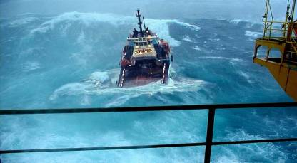
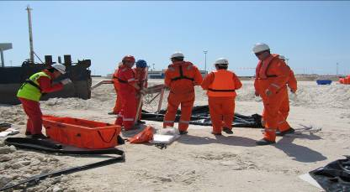
The Working Environment
  Extremes of temperature, humidity and precipitation all place considerable strain on human performance.
  Interface between oil, clean up chemicals and responders
  Potential exposure needs to be assessed and monitored
  Each product has its own characteristics that will determine the appropriate response
  Product characteristics will change based on weathering and other product interfaces
Notes:
Review environmental factors affecting safety including temperature, precipitation, exposure routes and changing product characteristics.

Slide 10
Manual Handling
  Always a risk on spills
  Minimise through training / supervision
  Always mechanise processes where possible
  Group lifts
  Rotation of staff
Notes:
Discuss manual handling risks. Explain correct lifting techniques, use of mechanical aids, team lifts and workforce rotation.

Slide 11
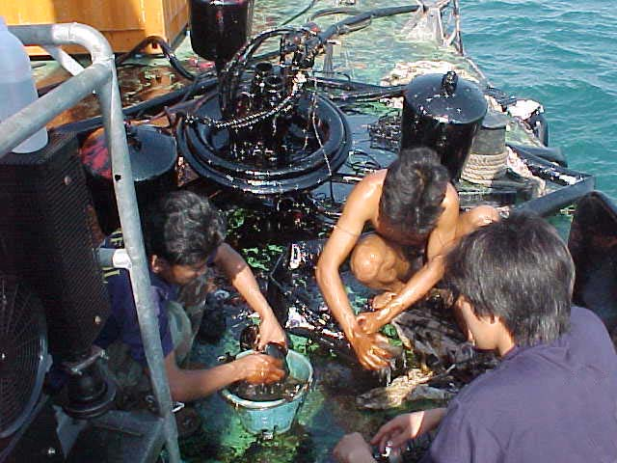
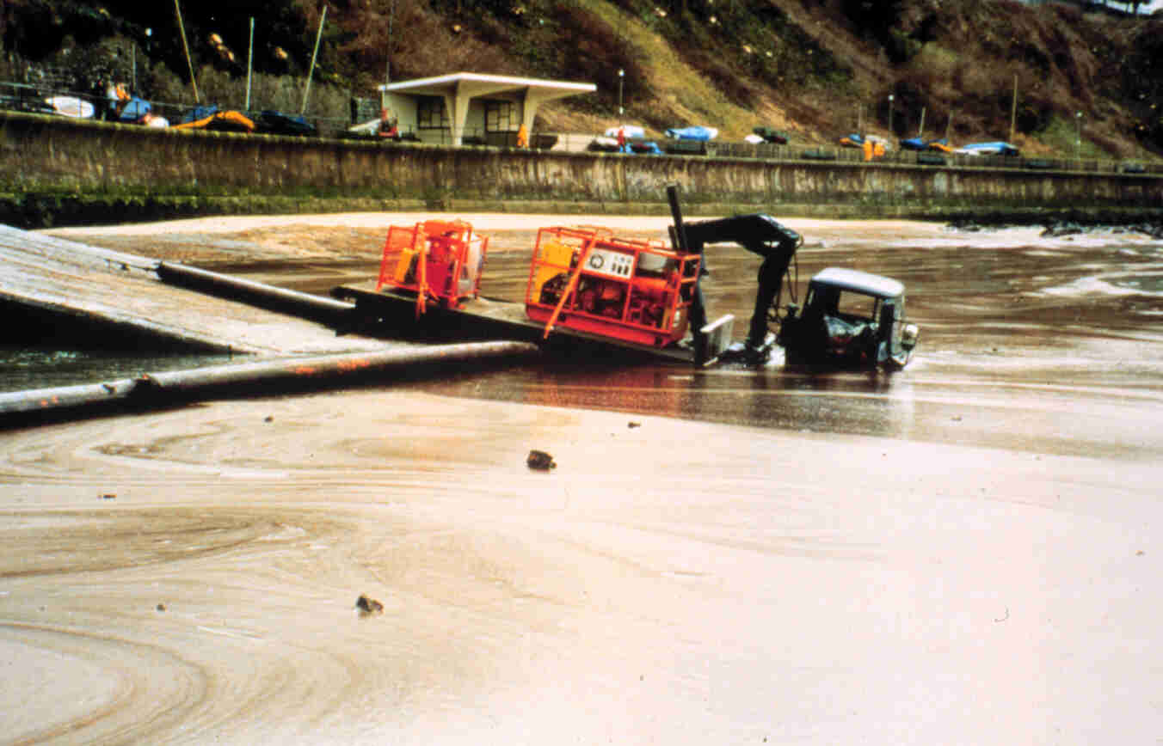
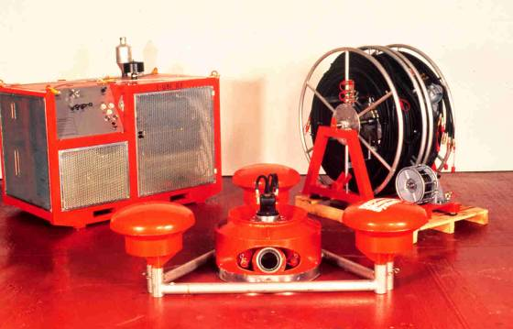
Equipment Hazards
Notes:
Review equipment-related hazards shown in each image and discuss safe lifting, isolation procedures, moving parts and hose safety.

Slide 12
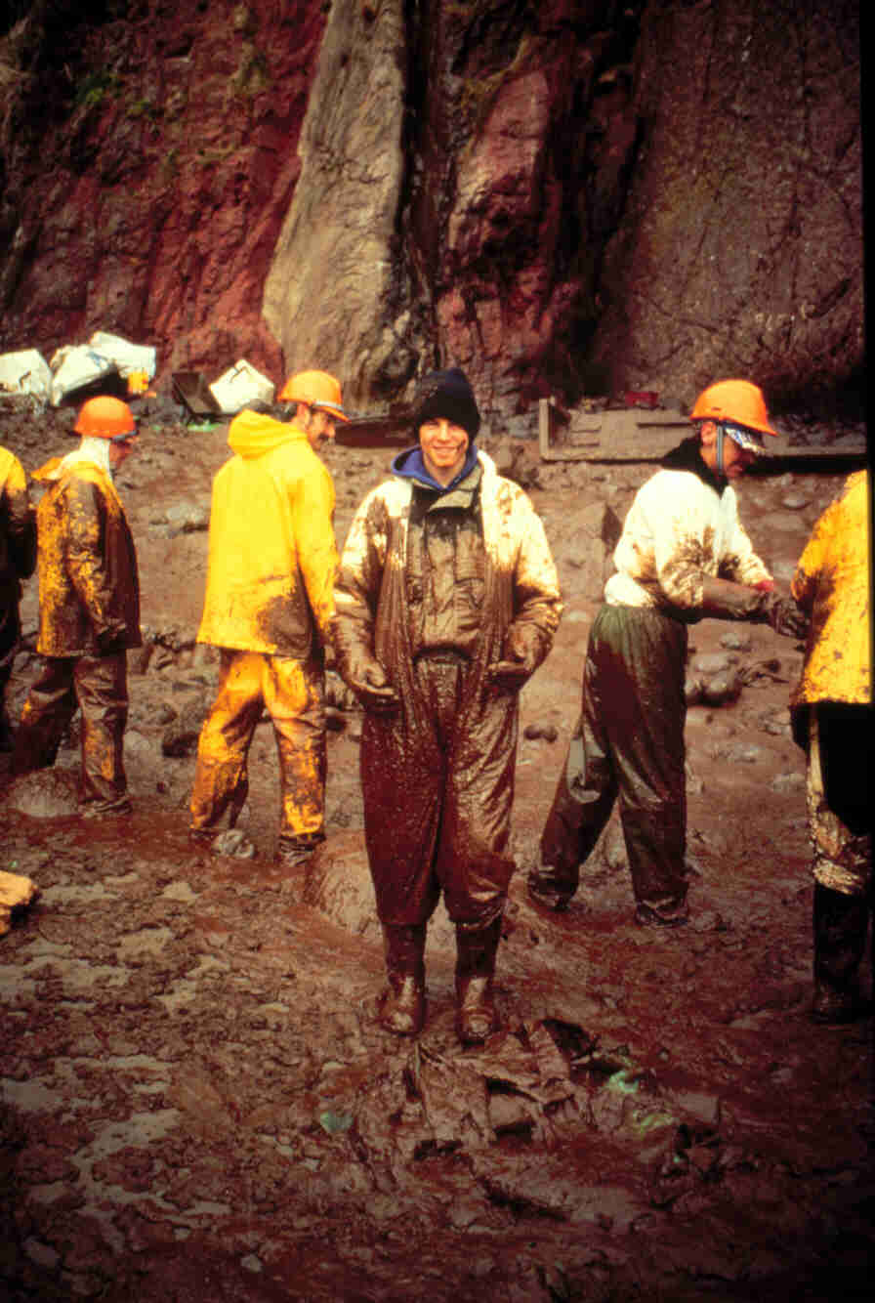
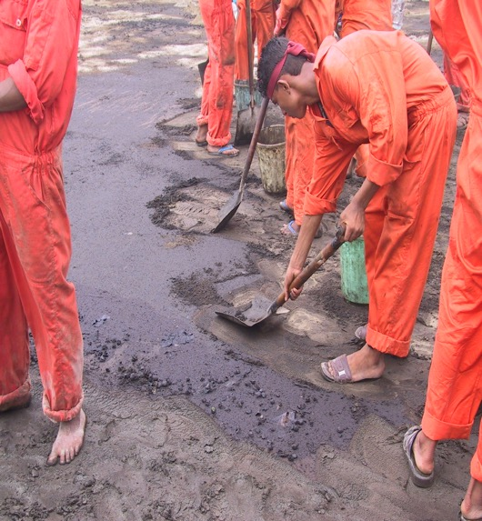
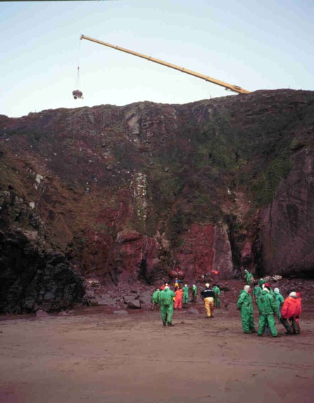
Your Fellow Responders
Notes:
Discuss human factors. Fatigue, communication failures, inexperience and poor supervision are frequently involved in incidents.

Slide 13
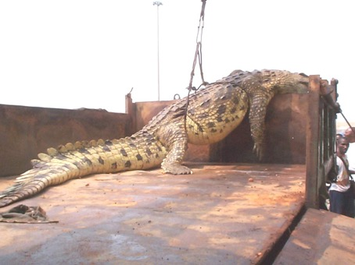
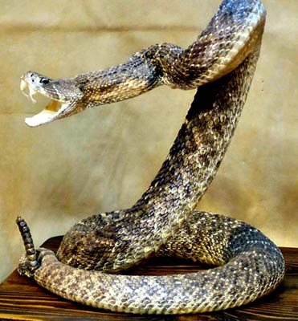
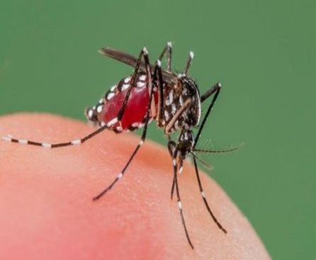
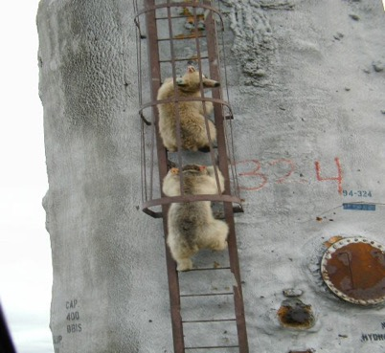
Wildlife
  Often overlooked
  Location dependant
  Build into your H&S brief
  Obtain local knowledge
Notes:
Review wildlife hazards and explain the importance of local knowledge. Discuss insects, reptiles, large animals and marine life as location-specific hazards.

Slide 14

Mitigating the Risk
How can we mitigate the risks on an oil spill?
Notes:
Facilitate a group discussion on risk mitigation. Record participant suggestions and relate them to the hierarchy of controls.

Slide 15
Mitigating the risk of clean-up operations
Safety Briefing
Hazards on site
MSDS
Site Control
Medical Plan
First aid
Medi-vac, emergency contact etc.
Risk Assessment
Hazards for task
Control measures
PPE
Correct PPE for different tasks/hazards
Compatibility
Site Survey
Supervision
Zoning and site setup
Notes:
Explain the key elements of a safe operation: risk assessment, briefing, site control, medical planning and PPE.

Slide 16
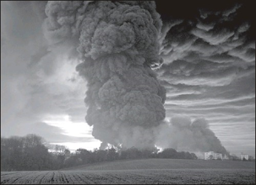
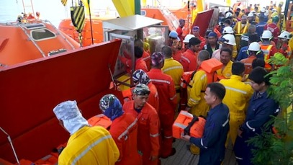

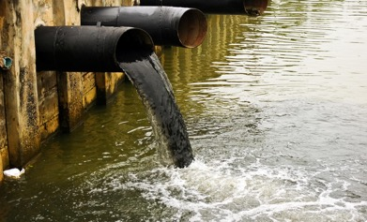
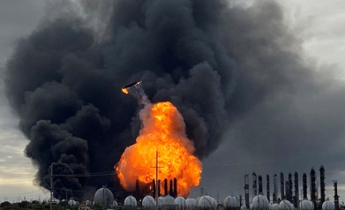
Risk Assessment
  Holistic assessment carried out at the beginning of the spill by management ………………what is the potential for…………..
Gas Cloud
Evacuation
Responder Safety
Wider impact
Explosion
Notes:
Discuss strategic risk assessment undertaken by management. Consider worst-case scenarios including evacuation, gas release and secondary incidents.

Slide 17
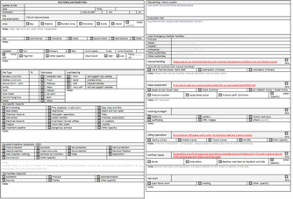
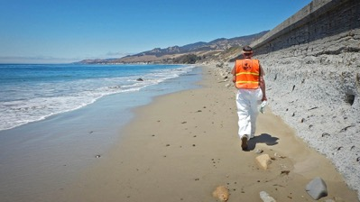
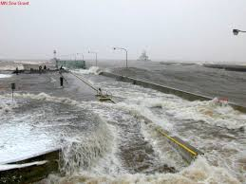
Risk Assessment
Site Specific operational Risk Assessment carried out prior to conducting spill mitigation activities…………..case by case…….
Formalised
Competent
Hazard v Risk
What are Hazards?
Anything that may cause harm, such as chemicals, electricity, working from ladders etc.
What is ‘Risk’?
The chance, that somebody could be harmed by a hazard.
Notes:
Explain site-specific risk assessments. Clarify the difference between a hazard and a risk and how formal assessments are documented.

Slide 18
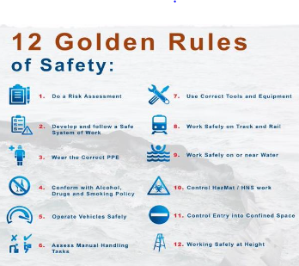
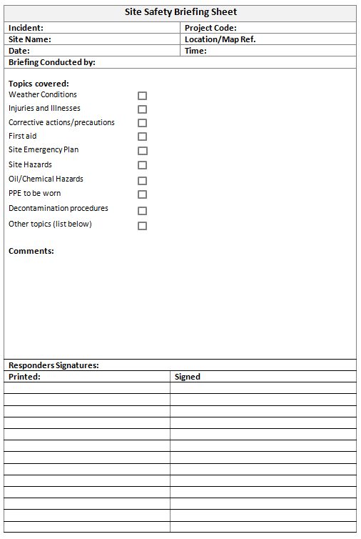
Safety Briefing
Notes:
Review the purpose of safety briefings. Emphasise communication of hazards, controls, emergency procedures and changes to conditions.

Slide 19
Site Entry
  Is the Site safe to enter
  Gas Monitoring
  Site Safety Survey
  Site Safety & Health Plan
  Site Specific Hazards
  Emergency Procedures
  Site Drawing/Layout
  Oiling Extent and Substrate type
Notes:
Discuss site entry requirements including gas monitoring, site surveys, emergency plans and understanding shoreline conditions.

Slide 20
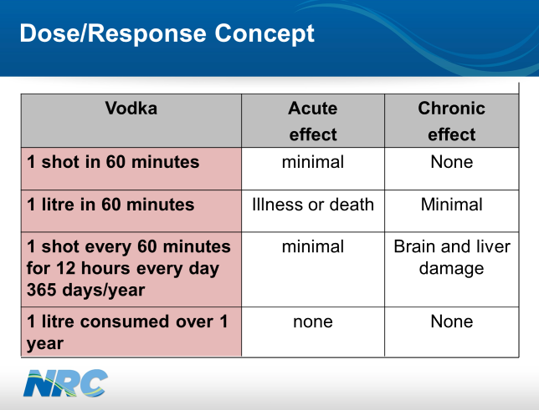
Gas Monitoring
There are two types of gaseous hazard associated with exposure to oil spills;
"Acute" effects usually occur rapidly as a result of short-term exposures and are of short duration.
  Hydrocarbons
  Oxygen
  H2S
"Chronic" effects generally occur as a result of long-term exposure and are of long duration.
Volatile Organic Compounds (VOC’s)
  Benzene
  Formaldehyde
  Toluene
  Xylene
Notes:
Explain acute and chronic exposure hazards. Review hydrocarbon gases, oxygen deficiency, hydrogen sulphide and VOC exposure risks.

Slide 21
Examples of Exposure Limits
Product E | 8 hr Time Weighted Average | Short Term Exposure Limit | Use
Benzene | 0.5 ppm | 2.5 ppm | Drugs, pesticides, plastics, detergents
Toluene | 50 ppm | No established | Paints, glue, printing, thinners
Formaldehyde | 2 ppm | 2 ppm | Glues, building products
Methylene Chloride | 25 ppm | 125 ppm | Pharmaceuticals, degreasing, paint remover, adhesives
Ethylene Glycol | 20 ppm | 40 ppm | Anti freeze, coolant
Petrol | 330 ppm | 500 ppm | Transportation
Naphthalene | 10 ppm | 30 ppm | Plastic, resins fuels
Notes:
Review exposure limit examples and explain why occupational exposure standards must be monitored and respected.

Slide 22

Personal Protective Equipment - PPE
Factors to consider when selecting PPE:
  Have all other control measure’s been considered
  Is it appropriate for the risks?
  Does it prevent or adequately control the risks involved without increasing the overall level of risk
  Is it of an acceptable standard
  Will the use of PPE shorten working times
Notes:
Discuss PPE selection principles. Explain that PPE is the final layer of protection after other controls have been implemented.

Slide 23
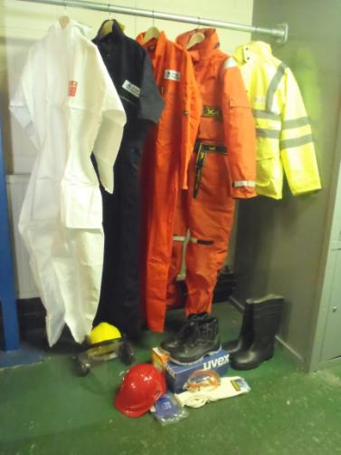
General Personal Protective Equipment
Luminous Jacket
Overalls
Wet weather gear
Immersion suit
Impervious Suit
Safety Shoes
Hearing Protection
Sock’s
Hard Hat
Safety Glasses
Rubber Gauntlets
Notes:
Review common PPE used during spill response and discuss minimum standards and task-specific requirements.

Slide 24
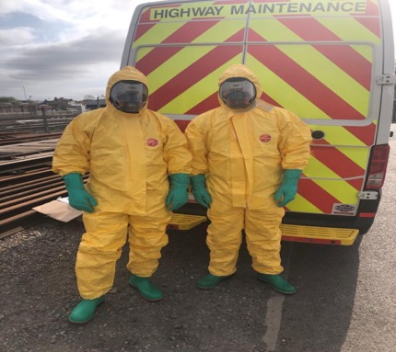
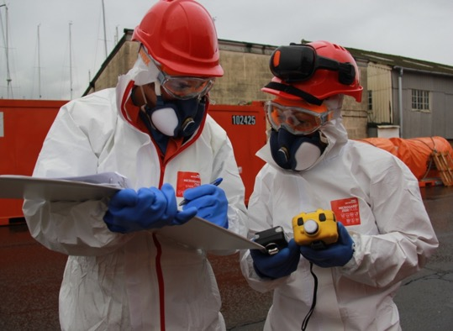
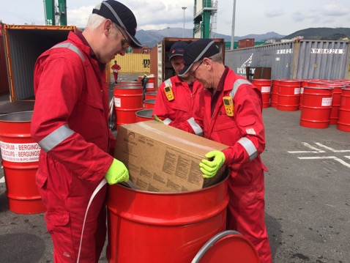
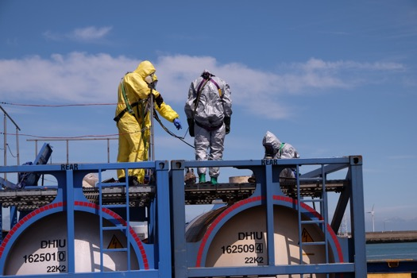
PPE may need to be specialised
Notes:
Explain situations where specialised PPE may be required, including respiratory protection, chemical suits and immersion protection.

Slide 25
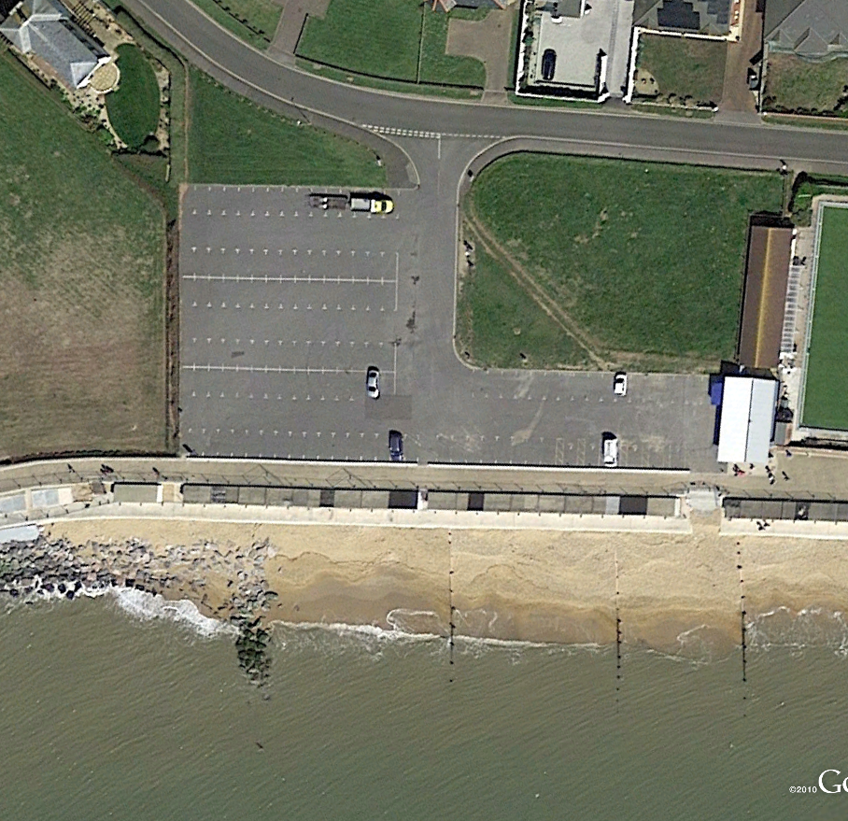
Site Control
COLD ZONE
COLD ZONE
FAP
Security
Security
Waste
Vehicle Area
WC
CP
Equipment Lay down area
Food & Shelter
Waste
EDA
Stores
Stores
WARM ZONE
PDA
W
W
HOT ZONE
Notes:
Review site zoning. Explain the purpose of hot, warm and cold zones and the functions of decontamination, welfare and command areas.

Slide 26
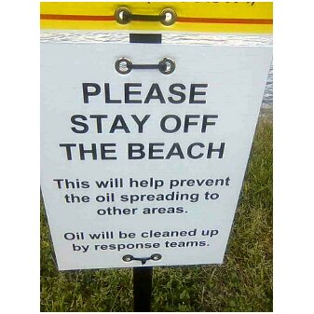
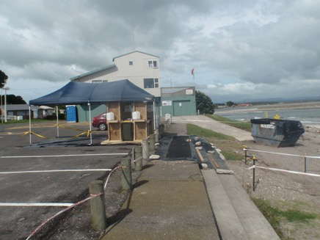
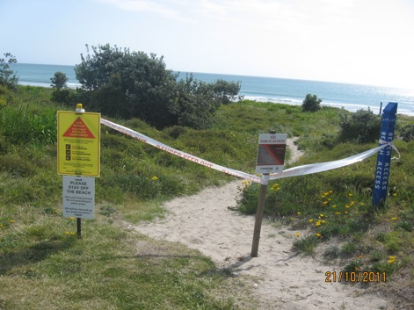
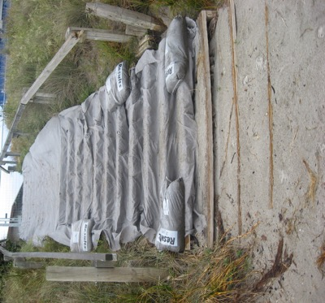
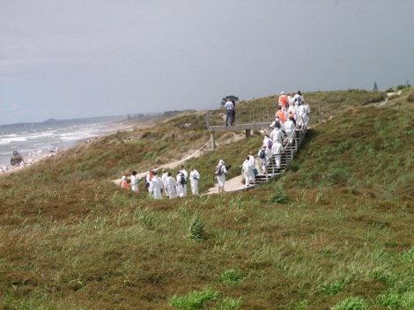
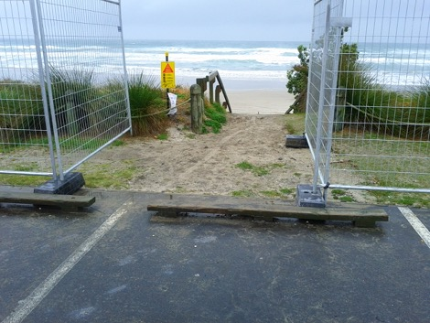
Access Control
Funnel effect
Barriers
Messaging
No Deviation
Defined Route
Access Protection
Notes:
Discuss access control measures. Explain barriers, defined routes, signage, security and movement control within the site.

Slide 27
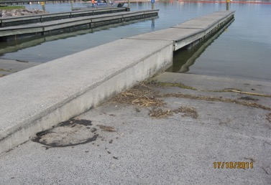
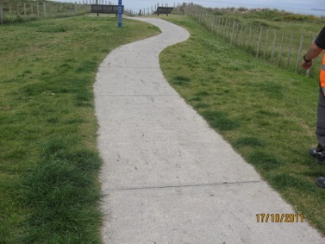
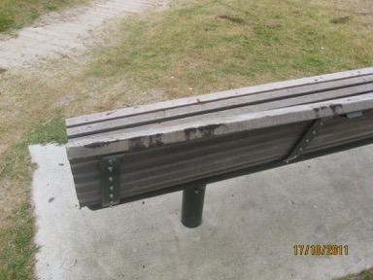
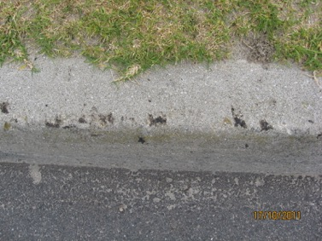
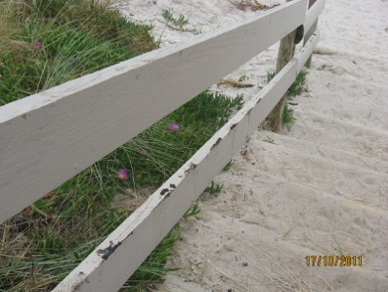
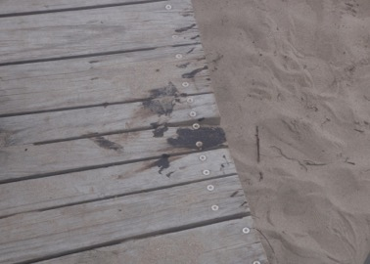
Managing the Decontamination Process
Trying to prevent the migration of the problem
Slipway
Pathway
Public Seating
Roadside
Boardwalk
Beach Access
Notes:
Explain why decontamination prevents the spread of contamination and protects responders, equipment and the public.

Slide 28
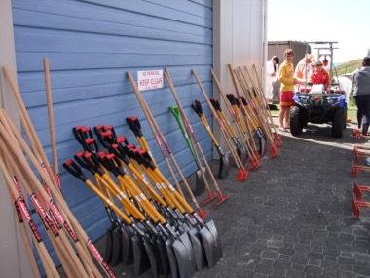
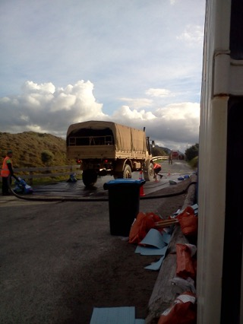
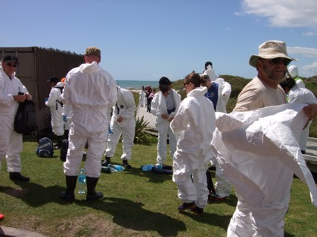
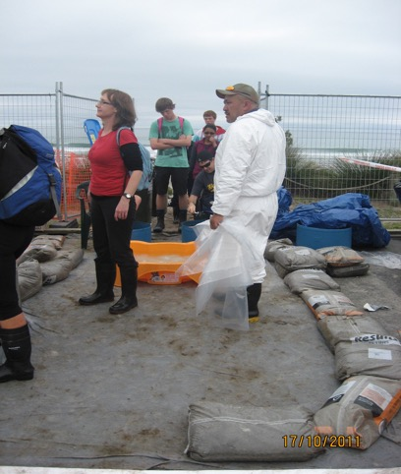




Resources that require Decontamination
Tools
Responders
Vehicles
Public
Vehicles
Vehicles
PPE
Public
Notes:
Review resources that may require decontamination including tools, vehicles, PPE, personnel and public access areas.

Slide 29





“Warm” Zone
Water source
Supervised
Portable
Channelled
Waste management
Notes:
Explain how a warm zone should operate, including supervision, water supply, waste management and contamination control.

Slide 30





Rolls Royce version
Notes:
Use the examples to show a fully developed decontamination system and discuss advantages over basic arrangements.

Slide 31

Hazards to Responders
Using the following pictures prepare a 5-minute safety brief including what PPE is required to give to the rest of the course as if they were your site workers
You have 10min for this task
Notes:
Facilitate the exercise. Ask participants to prepare and deliver a short safety briefing covering hazards, controls and PPE requirements.

Slide 32

Notes:
Debrief exercise findings. Discuss strengths and any hazards that may have been missed.

Slide 33

Notes:
Continue review of hazard identification and reinforce key learning points from the exercise.

Slide 34

Notes:
Discuss mitigation measures for the hazards shown and challenge participants to identify additional controls.

Slide 35

Notes:
Review operational planning considerations and how safety requirements should influence work methods.

Slide 36

Notes:
Discuss lessons learned from previous incidents and the importance of continuous monitoring and supervision.

Slide 37

Notes:
Summarise major safety themes including planning, communication, leadership and individual responsibility.

Slide 38

QS
Notes:
Use the image to identify marine response hazards such as slips, trips, falls, sinking risk, collision and seasickness.

Slide 39
You should now be able to.....
  List the hazards to responders from oil and substances.
  Identify the hazards from spill operations and explain how to mitigate them
  Explain safety assessment, recording and briefing procedures
  Identify key components of an oil spill clean-up site and explain the method of site control
Notes:
Review the learning outcomes and confirm participants can identify hazards, implement controls, conduct safety assessments and explain site control principles.

